Slide 1

Next Word Prediction Model Using Neural Networks
Internship Capstone Project Presentation
by
Samuel Kwame Dassi
AI/ML Intern
Thursday, 5th Oct 2023

Slide 2



Outline
Introduction
Results and Performance Metrics
Problem Statement
Application
Project Methodology
Live Demonstration
Unique Features
Conclusion

Slide 3
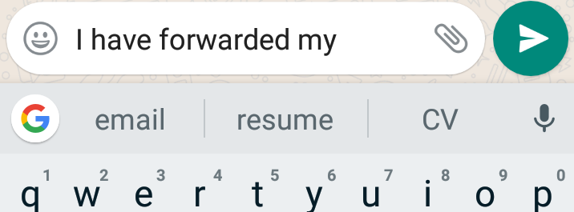
Introduction
Next Word Prediction means predicting the most likely word or phrase that will come next in a sentence or text
It is a language model which is able to anticipates the most likely word to follow a given sequence of words in a sentence or text
More like an inbuilt feature on an application that suggests the next word as you type or speak
Used in applications like messaging apps, search engines, virtual assistants, and autocorrect features on smartphones
In this project, I built a Next Word Prediction Model with Neural Networks

Slide 4

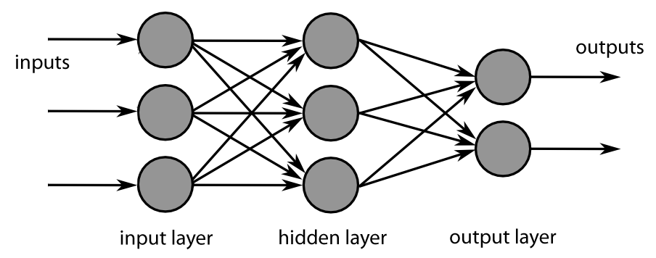
What is neural network
A neural network is a method in artificial intelligence that teaches computers to process data in a way that is inspired by the human brain
It uses interconnected nodes or neurons in a layered structure that resembles the human brain to solve a problems
A basic network has interconnected neurons in three layers:
Input Layer
Hidden Layer(s)
Output Layer

Slide 5
Problem Statement
The problem at hand revolves around the creation of an efficient and accurate next-word prediction model using neural networks
key issues that need to be addressed:
Why the Problem needs to be solved:
Context Sensitivity
Enhancing User Experience
Text Completion and Suggestions
Domain Adaptation
Rare and Ambiguous Word Prediction
Accessibility and Inclusion
Efficient Content Generation
Long-Range Dependencies
Mobile Devices and quick Communication

Slide 6
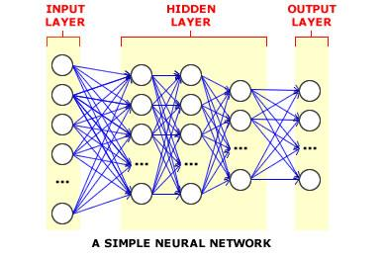
Solution
To solve the problems discussed earlier, a context-enhanced neural network architecture for next word prediction model was developed.
This architecture leverages the power of neural networks (Recurrent Neural Network (RNN) with Long Short-Term Memory (LSTM)) while incorporating innovative techniques that:
enhance context sensitivity
handle rare words
adapt to domains
capture long-range dependencies

Slide 7
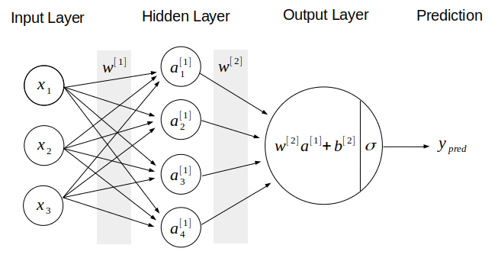
Methodology
Data Preprocessing
Download data
Clean data
Data Transformation
tokenize and Split data into input and output
Encode the data into suitable format
Build the Neural network architecture to train the model
Embedding layer
LSTM layer
Dense layer

Slide 8
Methodology Cont.
Compiling and training the model
Loss function(categorical cross-entropy)
Optimizer (Adam)
Training the model
Activation Function (Softmax)
Epochs (100)
Evaluation
Accuracy
Loss
Test the model

Slide 9
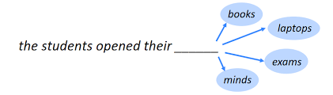
Unique Features
Able to Predict Uncommon Words Too: tricky or rare words
Understand Sentences Like Humans: context of what you're writing
Handles Long Sentences Smoothly:
Works Well in Different Writing Styles:
It will be Super Quick in Chat Apps
Suitable for people with special needs
The predicted word is the word with the highest likelihood (probability in vocabulary)

Slide 10
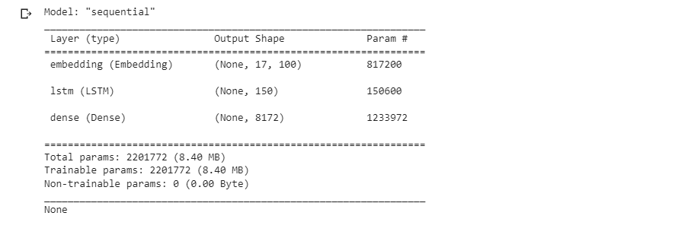
Model Architecture
The model is Sequential Model
Embedding layer takes input and output sequences of length 17 with each element 100 dimensional vectors. It has 817,200 trainable parameters.
LSTM layer takes input sequence of length 17 and output sequence of length 150. It has 150,600 trainable parameters
Dense layer has input vector of length 150 and output vector of length 8,172. It has 1,233,972 trainable parameters.
Total Trainable parameters of 2,201,772

Slide 11
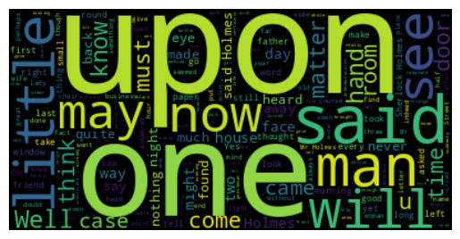
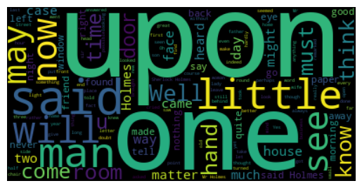
Results and Performance Metrics
Raw text data
Cleaned text data
The Wordcloud of the text data show the various words that make the text

Slide 12
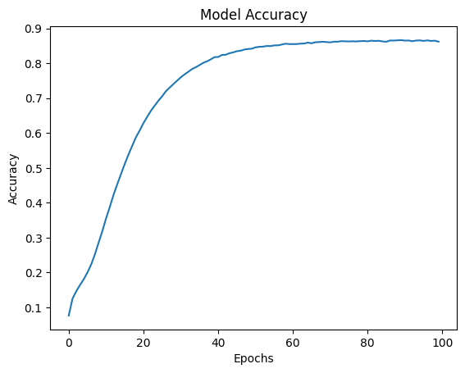
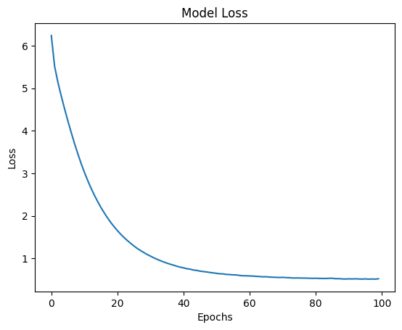
Results and Performance Metrics
The model records an accuracy of 0.8632 (86.32%) after the 100th iteration
The model records a loss value of 0.5207 after the 100th iteration

Slide 13
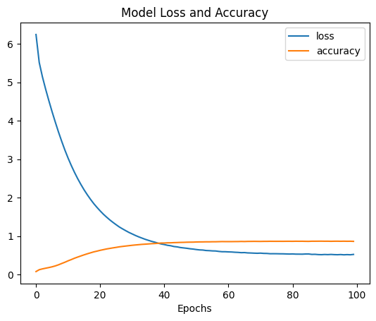
Results and Performance Metrics

Slide 14






Applications of the Model
The Next word prediction model can be applied in various systems
Next Word Prediction
Autocorrect Features on smartphones
Messaging apps
Virtual Assistants
Content Creation
Search Engines

Slide 15
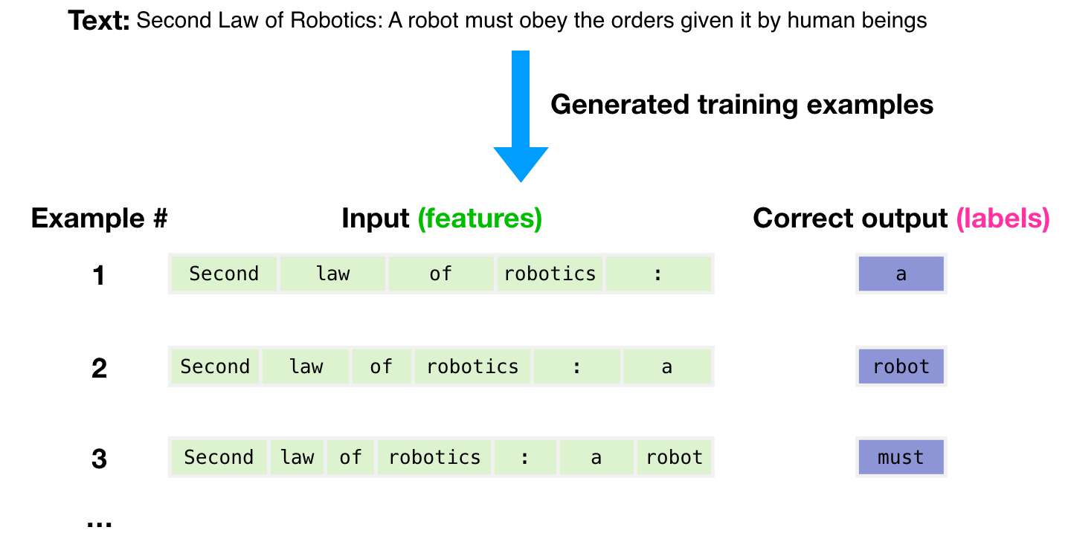
Conclusion
The Next word prediction model is a language model in Machine Learning that is able to predict the most probable word or sequence of words that follow a given input text
This model uses statistical patterns and language structures to generate accurate predictions based on the context provided
The model can be deployed in modern applications and systems such as chatbots and other AI tools
After the model, other software engineers can finetune it and integrate it into their software or systems

Slide 16
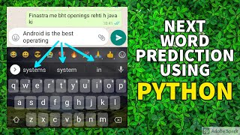
Live Demostration

Slide 17

Thank you!
Samuel Kwame Dassi
AI/ML Intern
Trestle Academy Ghana
+233240028612
https://www.linkedin.com/in/samuel-kwame-dassi/
dassi@trestleacademyghana.org

